Slide 1

Aim Games Platform
The reference platform for game-making resources
Group 7
Speaker: Mario Bizcocho González
Watch the advertisement!

Slide 2









A great way to get resources!

Slide 3

Contents
What is Aim Games?
Demonstration
Where we are
Team composition
Productivity control
Piloting plan
Issues faced
Next steps
Software control

Slide 4
Contents
What is Aim Games?
Demonstration
Where we are
Team composition
Productivity control
Piloting plan
Issues faced
Next steps
Software control

Slide 5
What is Aim Games?
Andalusian Association for the Promotion of Videogames
Provides human and technological resources
Includes experienced professionals

Slide 6
How are we making money?
Government aids
Company membership fees
Sublicensing administrative Access
Development events

Slide 7
Competitor analysis
 | AIM Games | Linkedin | Infojobs | Stratos | Icaro | Primerempleo | Jobrapido | Trabajos.com | Ibereoempleos
Forum | ✓ | ❌ | ❌ | ✓ | ❌ | ❌ | ❌ | ❌ | ❌
Verify CV | ✓ | ❌ | ❌ | ❌ | ❌ | ❌ | ❌ | ❌ | ❌
Share Resources | ✓ | ❌ | ❌ | ✓ | ❌ | ❌ | ❌ | ❌ | ❌
Direct Messaging | ✓ | ✓ | ❌ | ❌ | ❌ | ❌ | ❌ | ❌ | ❌
Courses | ✓ | ✓ | ✓ | ✓ | ❌ | ✓ | ❌ | ✓ | ✓
Company profiles | ✓ | ❌ | ✓ | ✓ | ✓ | ✓ | € | € | ✓
Sector specific | ✓ | ❌ | ❌ | ✓ | ❌ | ❌ | ❌ | ❌ | ❌
Organises events | ✓ | ❌ | ❌ | ❌ | ❌ | ❌ | ❌ | ❌ | ❌
Can challenge applicants | ✓ | ❌ | ❌ | ❌ | ❌ | ❌ | ❌ | ❌ | ❌
Notes:
AEVI: Asociación Española del Videojuego
STRATOS: offers both job opportunities and collaboration opportunities, the latter do not necessarily involve economical retribution. Also, severe lack of offers in Andalusia. Resembles a forum.
ICARO insecure: GET hacking when editing curricula

Slide 8
Differentiation
Intuitive design
Credibility
Proximity
Collaboration

Slide 9

Version model
www.aim-games-<iteration no>.herokuapp.com
www.aim-games-landing-page.herokuapp.com

Slide 10
GDPR
Simple wording
Privacy
Data protection officers
Breach information
Right to be forgotten
Right to port data

Slide 11
Contents
What is Aim Games?
Demonstration
Where we are
Team composition
Productivity control
Piloting plan
Issues faced
Next steps
Software control

Slide 12
Contents
What is Aim Games?
Demonstration
Where we are
Team composition
Productivity control
Piloting plan
Issues faced
Next steps
Software control

Slide 13
Where we are
Third iteration successful
Input from pilot plan used to improve platform
Added better messaging, improved paid functionality and QoL improvements

Slide 14
Where we are
Concept | Net cost
Direct costs (salaries, social costs, others) | €32258.01
Indirect costs | €322.58
Reserves | €3258.06
Profit | €4887.09
Total before tax | €40725.74
VAT (21%) | €8552.41
Total | €49278.15
Notes:
Capital revenue: regional government aids to associations, company membership fees,

Slide 15
Where we are
Name | Role | Price/hour | Invested hours | Gross Salary | Social costs | Total
De la Fuente Bonilla, Fco. Javier | CEO, Project Manager | 25€/h | 150h | 3750€ | 1124.63€ | 4874.63€
Molina Domínguez, Jorge Manuel | CCO, CIO | 22,73€/h | 150h | 3409,5€ | 1022.51€ | 4432.01€
Bizcocho González, Mario | CMO, Speaker | 22,73€/h | 150h | 3409,5€ | 1022.51€ | 4432.01€
Monteseirín Puig, Alejandro | Full-stack Developer | 18,54€/h | 150h | 2781€ | 834.03€ | 3615.03€
Pérez Piñero, Iván | Backend Developer | 15,37€/h | 150h | 2305.5€ | 689.35€ | 2994.85€
Arenas Arenas, Antonio | Frontend Developer | 15,37€/h | 150h | 2305.5€ | 689.35€ | 2994.85€
Santos Batista, Miguel | Full-stack Developer | 18,54€/h | 150h | 2781€ | 834.03€ | 3615.03€
Pazo Jiménez, Pablo | Backend Developer | 15,37€/h | 150h | 2305.5€ | 689.35€ | 2994.85€
 |  |  |  | 23047,5€ | 6905.76€ | 29953,75€
Notes:
Capital revenue: regional government aids to associations, company membership fees,

Slide 16
Where we are

Slide 17
Contents
What is Aim Games?
Demonstration
Where we are
Team composition
Productivity control
Piloting plan
Issues faced
Next steps
Software control

Slide 18
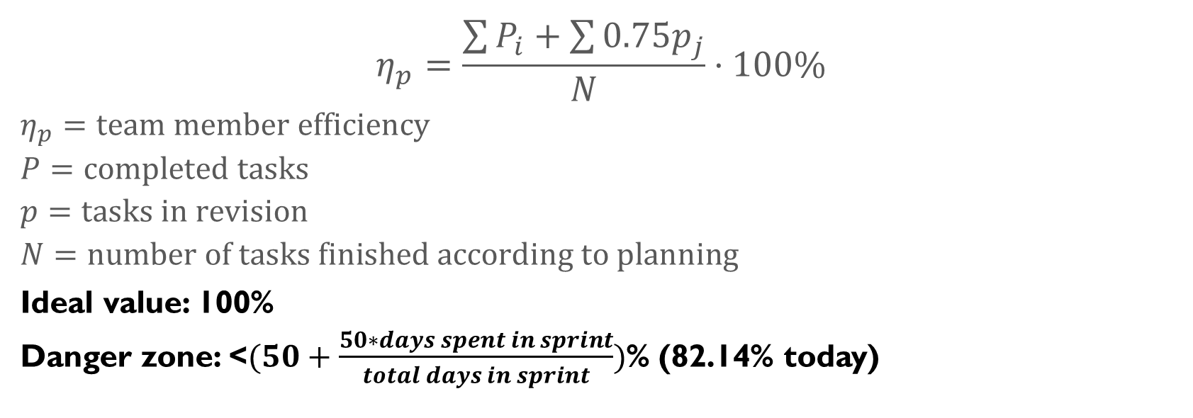
Productivity plan
$$η_{p}=\frac{\sum{P_{i}}+\sum{{0.75p}_{j}}}{N}·100\%$$
$$η_{p}=team member efficiency$$
$$P=completed tasks$$
$$p=tasks in revision$$
$$N=number of tasks finished according to planning$$
Ideal value: 100%
Danger zone: <$(50+\frac{50∗days spent in sprint}{total days in sprint})$% (82.14% today)

Slide 19
Punishment strategy
3 warning system
Expulsion at the 3rd warning
Automatic warning for incompletion
Proposed warning (voting)
Pardoning of warning on sprint without incidents

Slide 20
Contents
What is Aim Games?
Demonstration
Where we are
Team composition
Productivity control
Piloting plan
Issues faced
Next steps
Software control

Slide 21
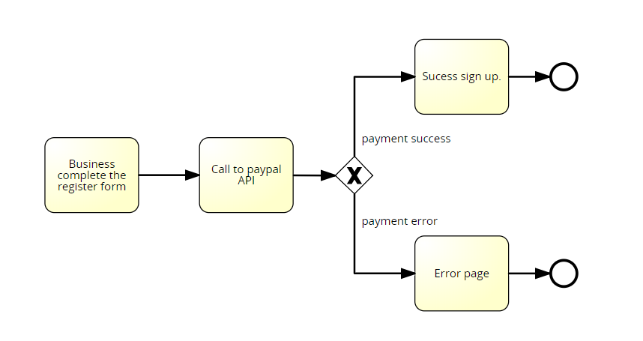




Issues faced
Issue 1: PayPal
Issue 2: Database
Issue 3: Git
Issue 4: Manager role
Issue 5: PPT bug

Slide 22

Issues faced
Issue 6: Communication breakdown

Slide 23

Issues faced
Issue 7: PayPal payment recognition

Slide 24
Contents
What is Aim Games?
Demonstration
Where we are
Team composition
Productivity control
Piloting plan
Issues faced
Next steps
Software control

Slide 25

Automated testing

Slide 26

Quality assurance
Google Lighthouse

Slide 27
Contents
What is Aim Games?
Demonstration
Where we are
Team composition
Productivity control
Piloting plan
Issues faced
Next steps
Software control

Slide 28

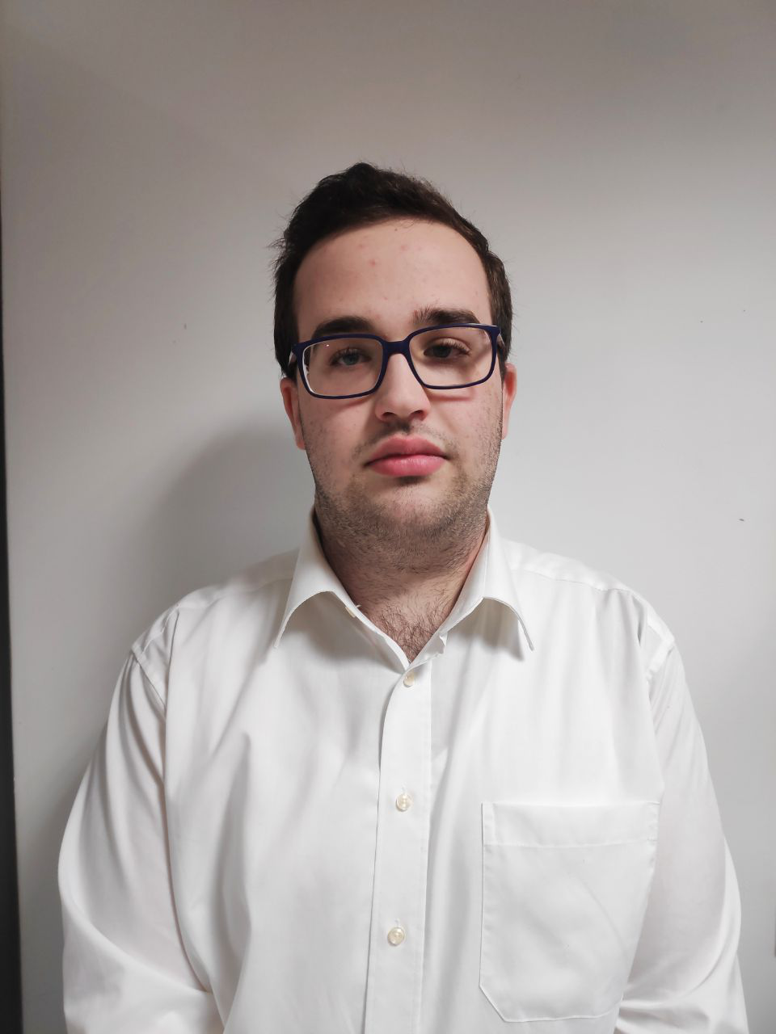
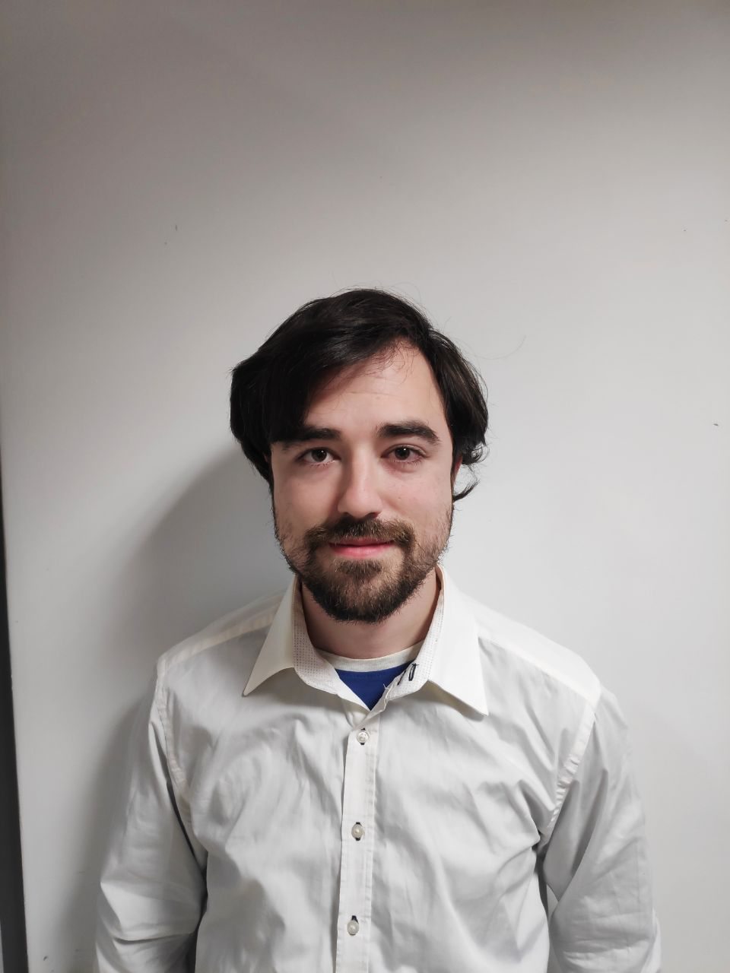
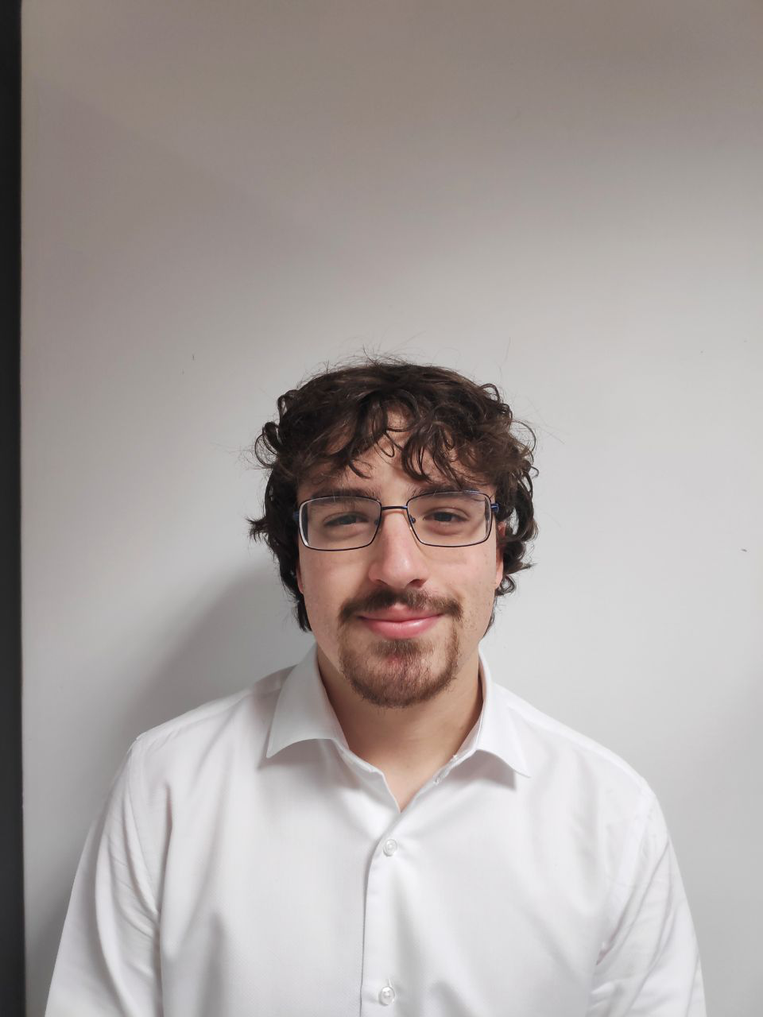
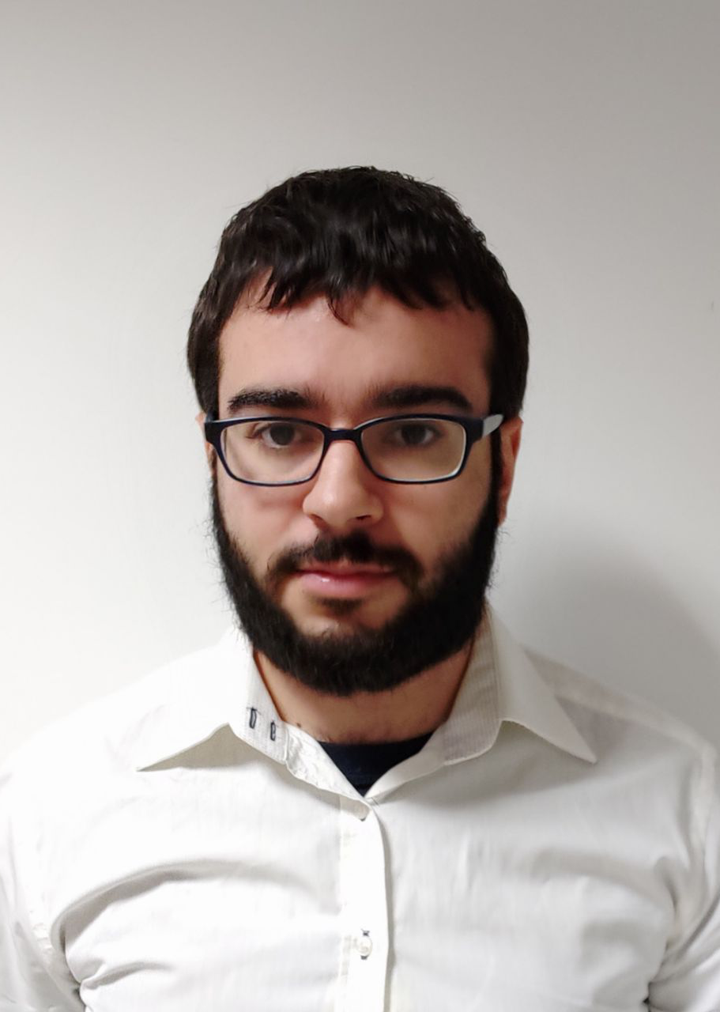
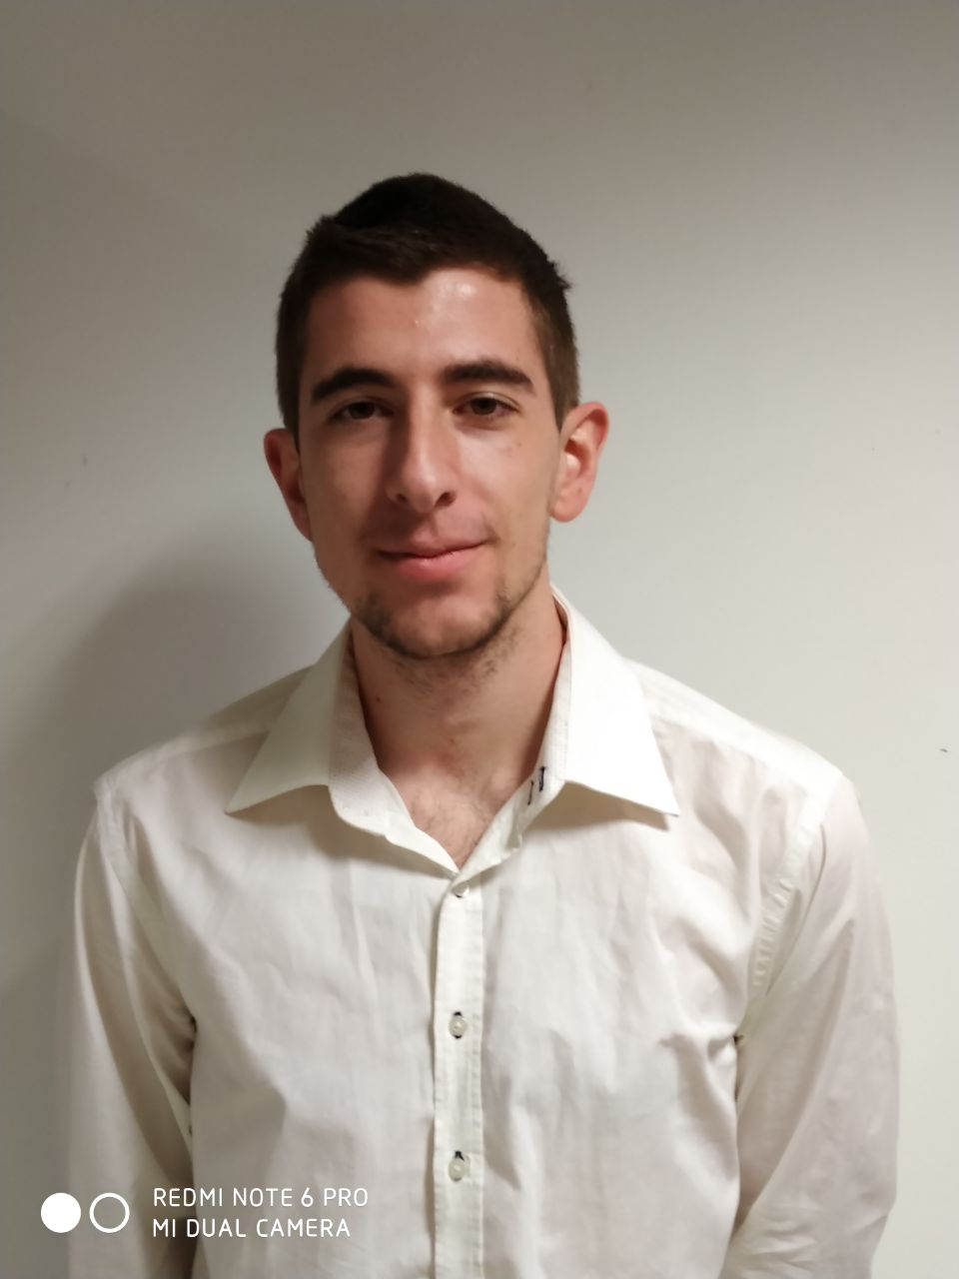
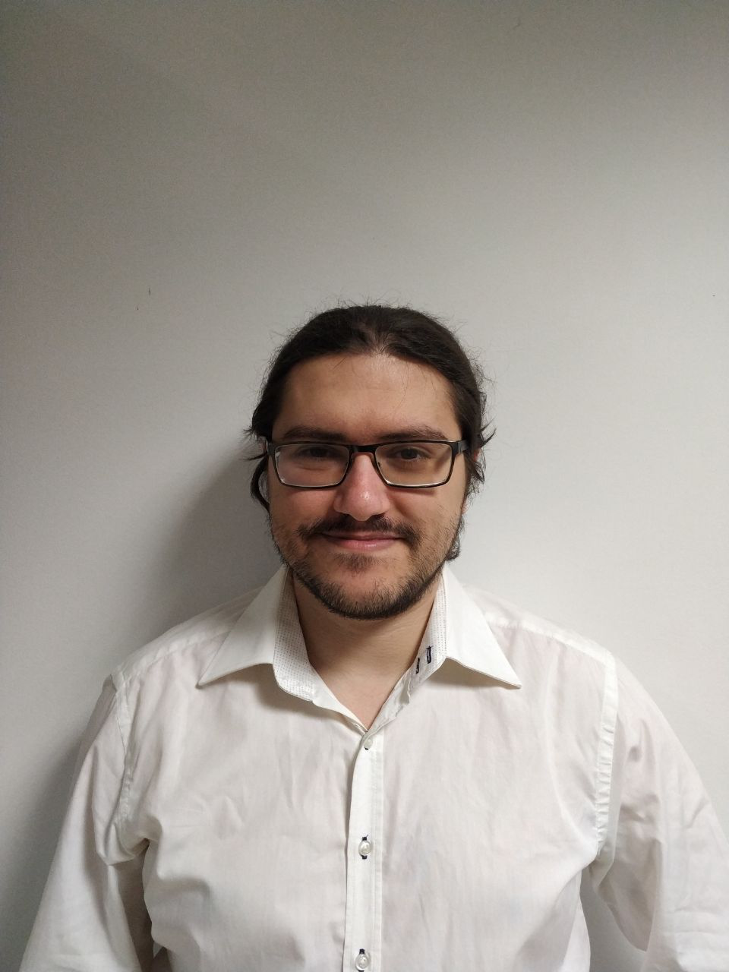
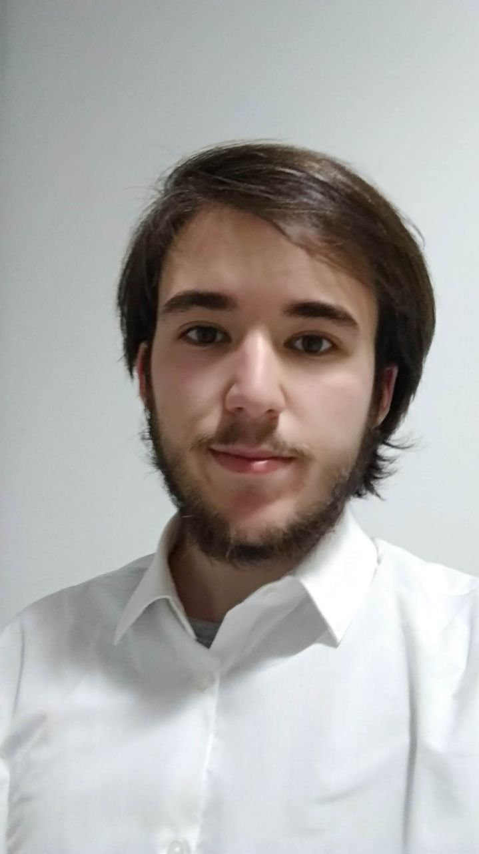
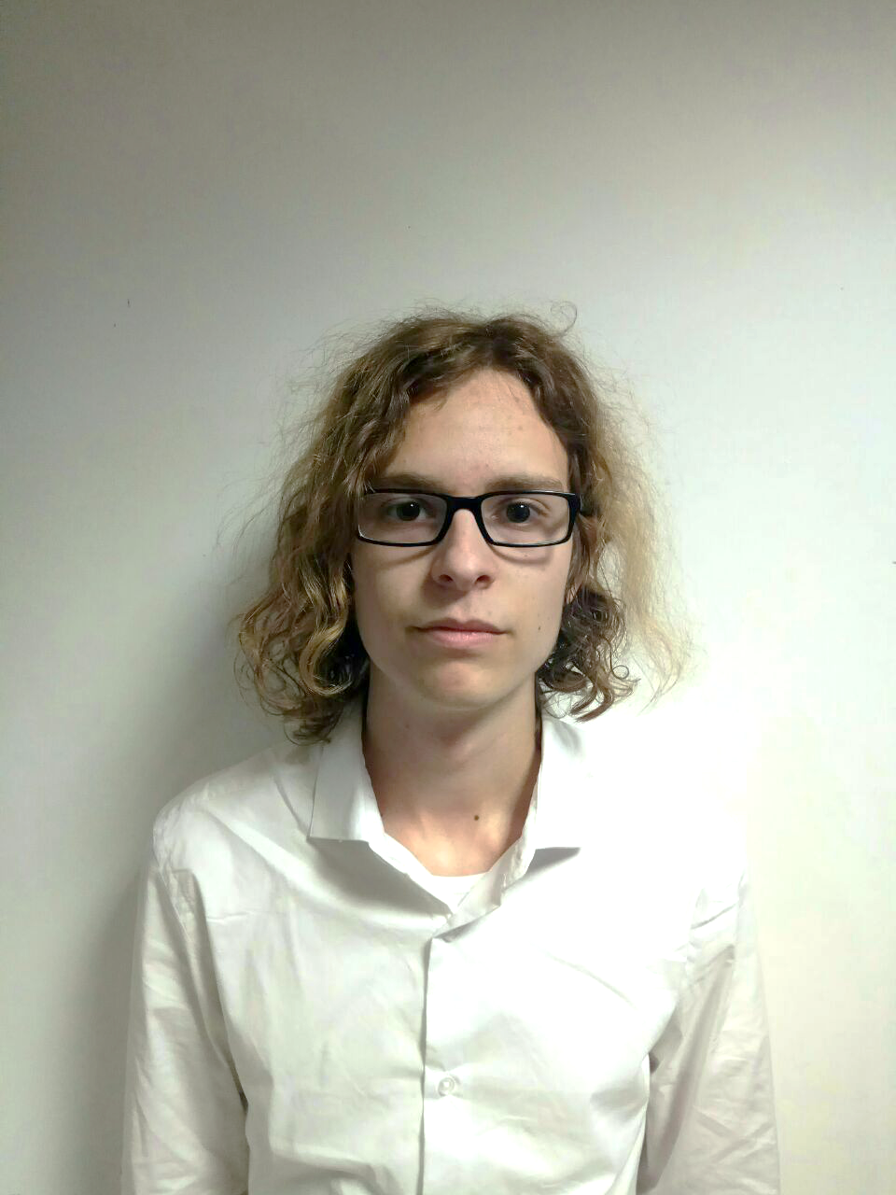

Development plan
1 | 2 | 3 | 4 | 5 | 6 | 7 | 8 | 9 | 10 | 11 | 12 | 13 | 14
Management, testing and CSS revamp
All the team
Parallel task – all project
11.5
/
10
each

Slide 29

Development plan
1 | 2 | 3 | 4 | 5 | 6 | 7 | 8 | 9 | 10 | 11 | 12 | 13 | 14
Forms: calendar
Forms: required fields
Messaging
Fco. Javier de la Fuente
100%
8.5
/
10

Slide 30
Development plan
1 | 2 | 3 | 4 | 5 | 6 | 7 | 8 | 9 | 10 | 11 | 12 | 13 | 14
CSS work and fixes
Alejandro Monteseirín
100%
14
/
15

Slide 31
Development plan
1 | 2 | 3 | 4 | 5 | 6 | 7 | 8 | 9 | 10 | 11 | 12 | 13 | 14
Enhance search engine
Pablo Pazo
100%
9
/
9

Slide 32
Development plan
1 | 2 | 3 | 4 | 5 | 6 | 7 | 8 | 9 | 10 | 11 | 12 | 13 | 14
Payment tiers
Create coin system
Miguel Santos
100%
13
/
14

Slide 33
Development plan
1 | 2 | 3 | 4 | 5 | 6 | 7 | 8 | 9 | 10 | 11 | 12 | 13 | 14
Thread rename
Notification on event
Presentation tasks
Mario Bizcocho
100%
11
/
12

Slide 34
Development plan
1 | 2 | 3 | 4 | 5 | 6 | 7 | 8 | 9 | 10 | 11 | 12 | 13 | 14
CSS QA
Unit testing
Antonio Arenas
100%
11
/
12

Slide 35
Development plan
1 | 2 | 3 | 4 | 5 | 6 | 7 | 8 | 9 | 10 | 11 | 12 | 13 | 14
Unverify curricula
Freelancer premium
Iván Pérez
100%
8.5
/
9

Slide 36
Development plan
1 | 2 | 3 | 4 | 5 | 6 | 7 | 8 | 9 | 10 | 11 | 12 | 13 | 14
Fix T&C
Conference day
Documentation
Jorge Manuel Molina
100%
11
/
11

Slide 37
Contents
What is Aim Games?
Demonstration
Where we are
Team composition
Productivity control
Piloting plan
Issues faced
Next steps
Software control

Slide 38


Piloting plan
Companies
TieSoft: Rafael Sánchez
Dual Mirror Games: Daniel Marín
Gunstar Studio: Rafael Casaucao
Base members
Alberto Sánchez
Vinnicios Thyago Dias
Francisco Sánchez
… Experience design testers
Anyone can join!
Around 50 members to be polled at street level
Notes:
Grupo 7

Slide 39
Piloting plan
Two stages
Defined use cases
Time tracking
No guidance
User experience testing
Two test roles

Slide 40

Piloting plan
Added
User picture should not be mandatory
Future improvements
Answers to challenges listed by challenger
Explain what challenges are
Aesthetical fixes
Coin system for challenges & offers, subscription models
Better search functionality
Free business demo
Tags on events

Slide 41
Contents
What is Aim Games?
Demonstration
Where we are
Team composition
Productivity control
Piloting plan
Issues faced
Next steps
Software control

Slide 42
Next steps
Make business plan and marketing material
Preparing project launch
Delivering product

Slide 43

Thank you for your time!
If I have seen further it is by standing on the shoulders of Giants
- Isaac Newton
Summer in Mara (Chibig, Valencia, 2019)
Any questions?
Notes:
Grupo 7

